Slide 1
CURRENCY CONVERTER

Slide 2
TEAM MEMBERS
T.Harshavardhan -99210041292
T.Shantan -9921004711
U.Sasi kumar -99210041646
V.Prasanth kumar -99210042163

Slide 3
INTRODUCTION
Currency converter is a tool used to convert one country’s currency to another.
In this project by the knowledge of usage of currency converter a program is designed in java language.
In this Currency Converter application, it is going to display a web page where you can choose to display the converter or the exchange rate of one currency with all other currencies in the form of table.

Slide 4
ABSTRACT
Different countries use different currency, and there is daily variation in these currencies relative to one another.
Those who transfer money from one country to another (one currency to another) must be updated with the latest currency exchange rates in the market.
Currency converter mini project is built keeping this thing in mind.
This application can be used by any user, but it is mainly useful for business, shares, and finance related areas where money transfer and currency exchange takes place on a daily basis.

Slide 5
ABSTRACT
It is a useful tool which gives us the value of certain amount of one currency to be converted in to a different currency.
In this project we are going to display web window that contains three buttons like single conversion ,multiple conversion and history.
The respective Buttons provide the output as per the functions allotted to the buttons.

Slide 6
EXISTING SYSTEM
In the existing system we can convert a single type of currency into another type according to our selection.
It is difficult to do more conversions and it takes time to perform the different types of conversions. Like if we want to do multiple conversions it takes time.
We can overcome this by doing small changes in the existing system.

Slide 7
PROPOSED SYSTEM
The main frame contains three buttons as single conversion, multiple conversion and history.
Single conversion button converts one type of currency into another type of the currency as per the user input.
A Button named “Multiple Conversion” converts one type of currency into some of the important currencies.
Another button named “History” shows the value of currency in the respective year in the respective country.
By this we can overcome the disadvantages of existing system

Slide 8
MODULES
java.awt.*;
java.awt.event.ActionEvent;
java.awt.event.ActionListener;
java.awt.event.ItemEvent;
javax.swing.*;

Slide 9
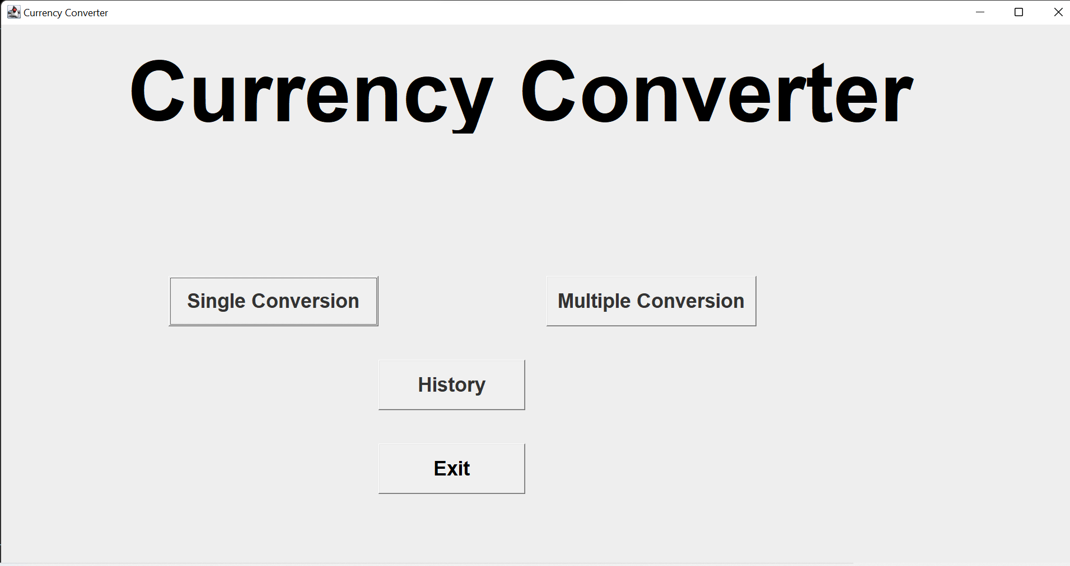
Screenshot of the main frame:

Slide 10
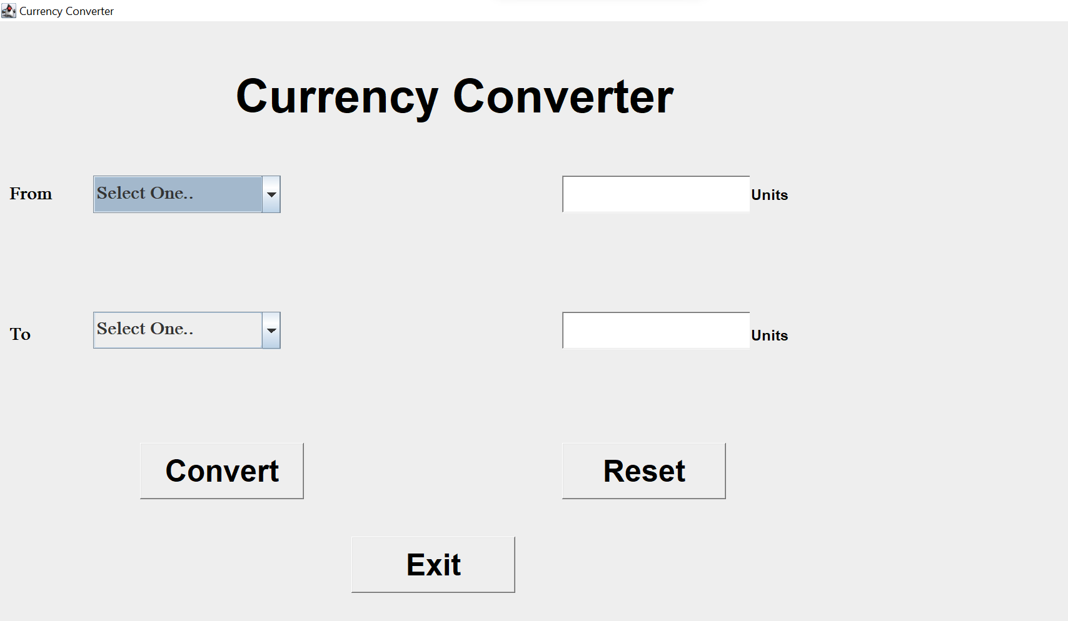
Screenshot of Frame after clicking on Single Conversion:

Slide 11
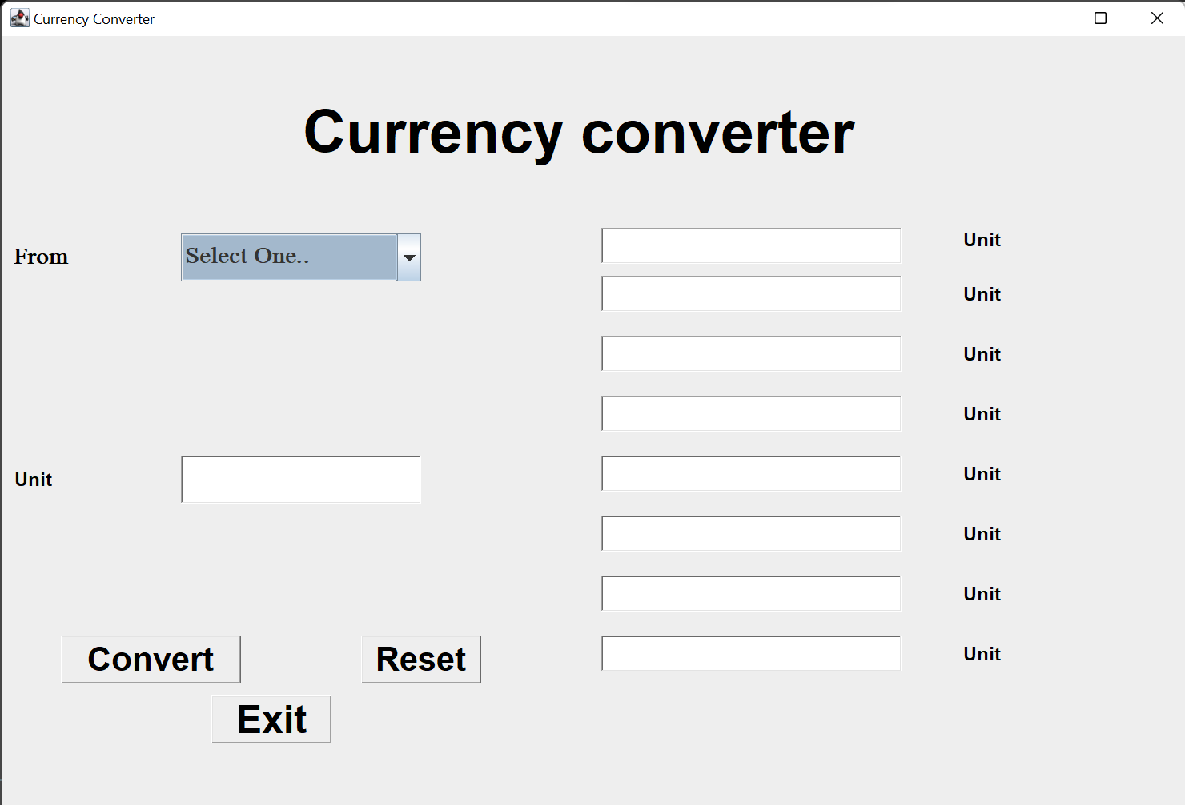
Screenshot of Multiple Conversion:

Slide 12
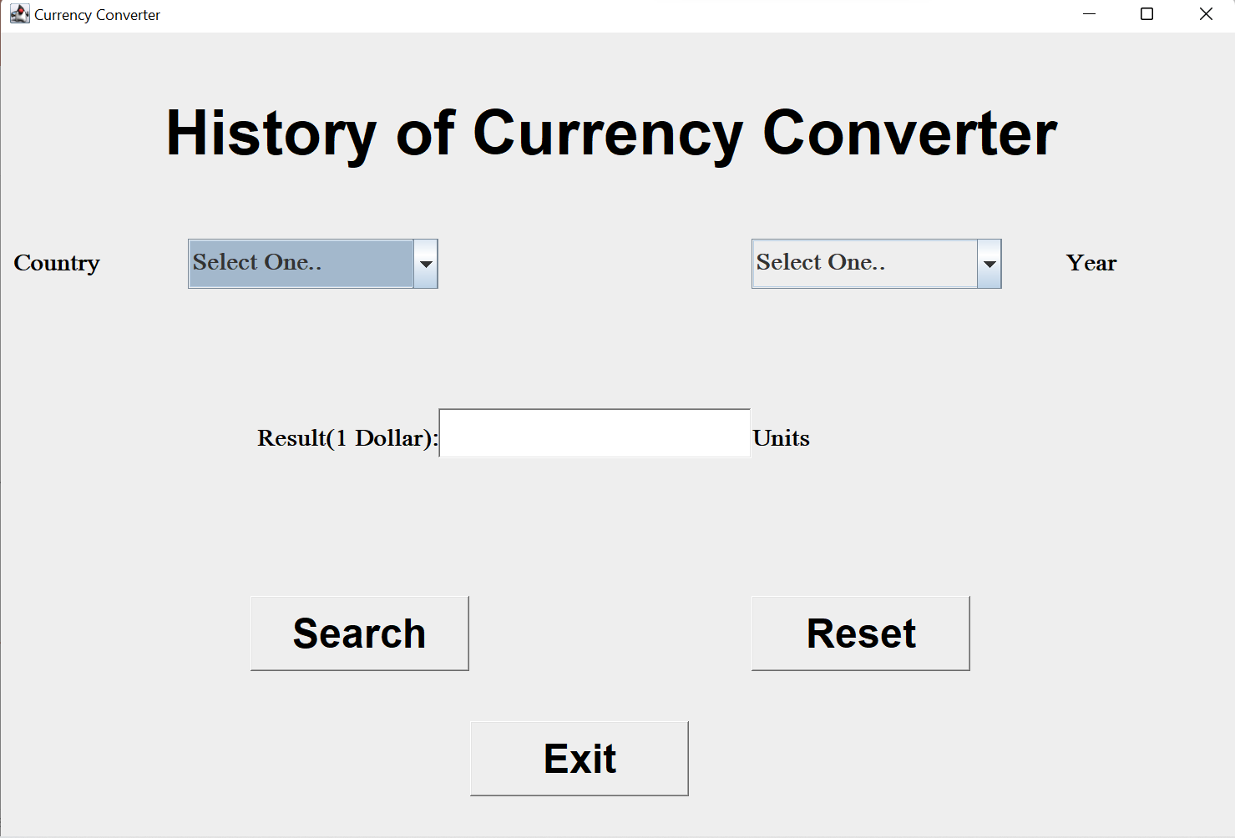
Screenshot of History:

Slide 13
REFERENCES
JavaTpoint
Greek for Greeks
https://projectworlds.in/java-projects-with-source-code/currency-converter-java-mini-project/
Ahmed Amine Lamzour “Literature Review: Fundamental Analysis andTechnical Analysis of the Exchange Rate” IJSER Volume 9, Issue 8, August-2018 ISSN 2229-5518.

Slide 14
THANK YOU

